Slide 1


Problem Statement ID : Health Tech & MedTech PS5
HACK KRMU 5.0
Team Name : Eco Vision Belt
TEAM ID : HK148
TEAM MEMBERS : Bishnu Kumar (Team Leader)
Anirudh Chauhan
01

Slide 2
HACK KRMU 5.0
Problem
Visually impaired people struggle with independent navigation.
White cane detects only ground-level obstacles.
Cannot detect head or chest-level obstacles.
Advanced smart devices are expensive.
Need for affordable, wearable, real-time obstacle detection.
02

Slide 3
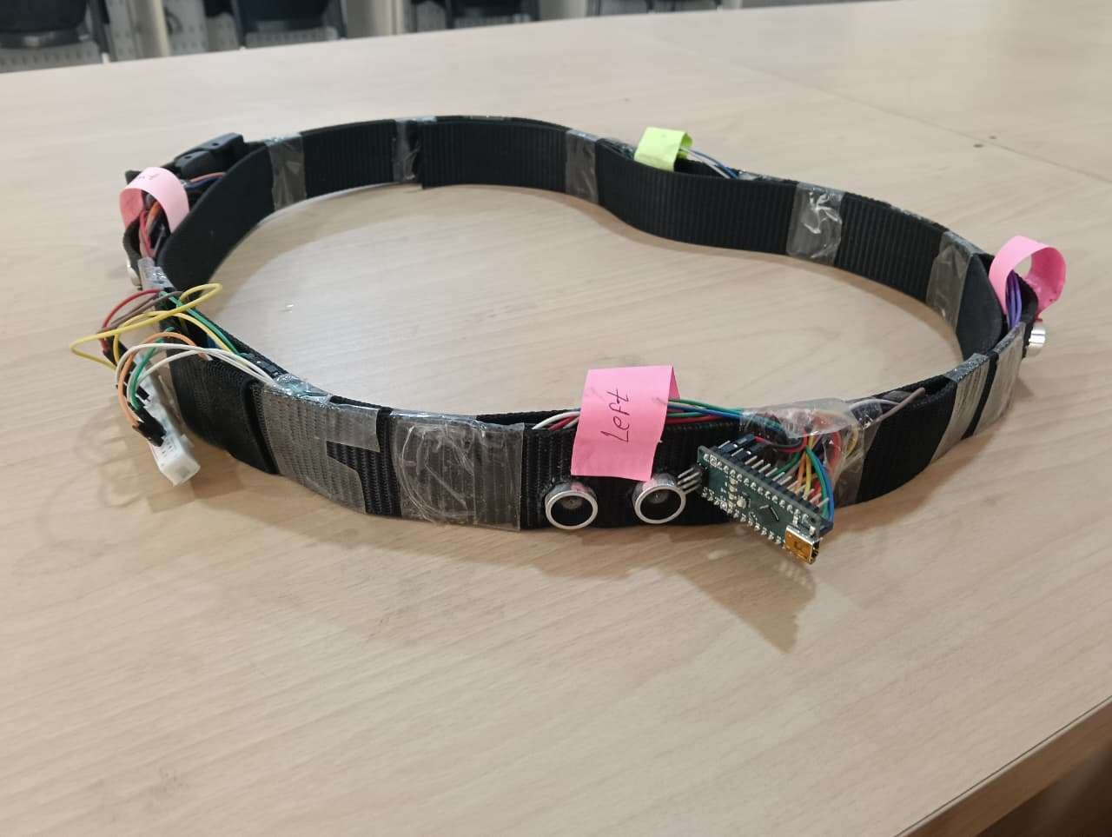
HACK KRMU 5.0
Solution
Wearable belt with ultrasonic sensors.
Detects obstacles in front, left, and right.
Gives voice alerts about distance and direction.
Hands-free and lightweight.
Low-cost and energy-efficient design.
02

Slide 4
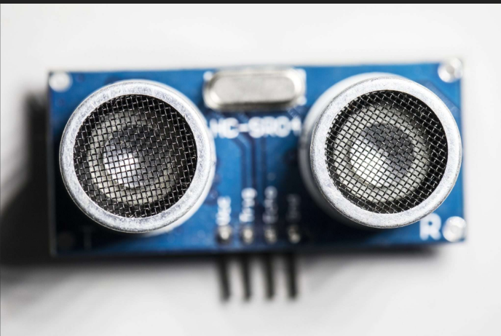
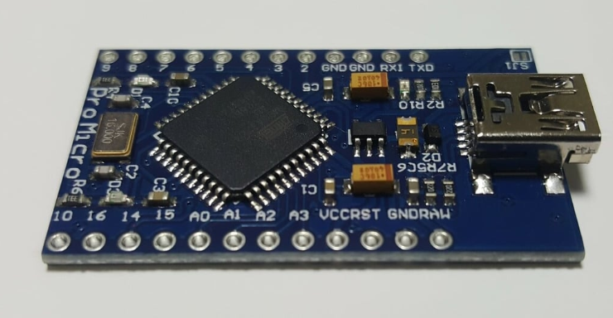
HACK KRMU 5.0
Flow of Solution
Sensor sends ultrasonic waves.
Waves hit obstacle and return.
Microcontroller calculates distance.
If object is near → trigger alert.
Voice message tells direction and distance.
Process repeats continuously.
03

Slide 5
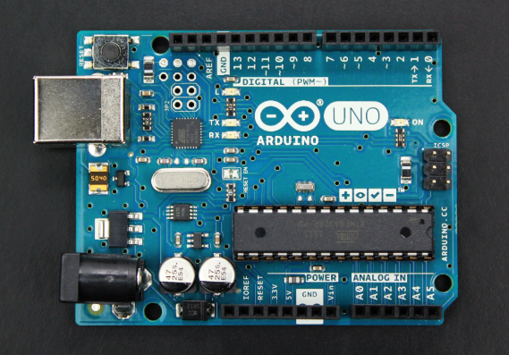
HACK KRMU 5.0
TECH STACK
Hardware:
Ultrasonic Sensors (HC-SR04)
Arduino Nano / ESP32
Voice Module (DF Player Mini)
Speaker
Rechargeable Battery
Software:
Embedded C/C++ (Arduino IDE)
Distance calculation logic
Threshold-based alert system
APPROACH
Multi-sensor placement on belt
Real-time processing
Low power design
04

Slide 6
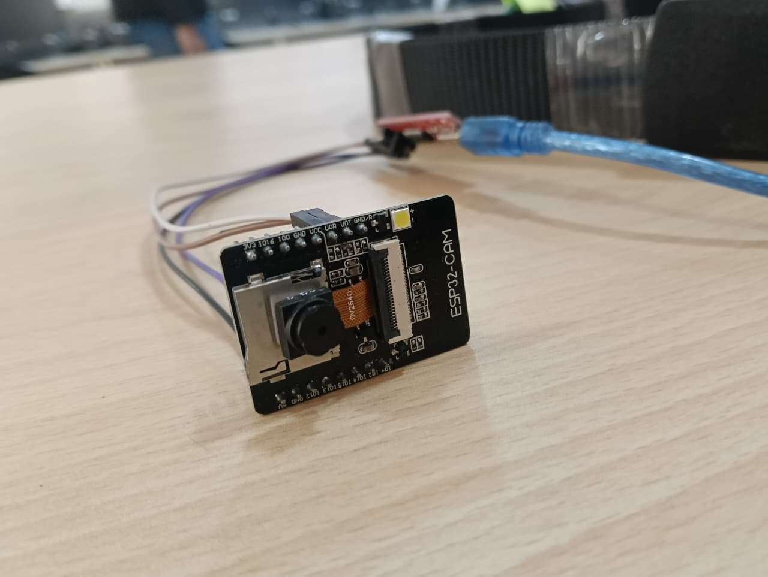
HACK KRMU 5.0
UNIQUENESS & INNOVATION FACTOR
Waist-mounted for better coverage.
Detects mid-level and head-level obstacles.
Direction-based voice alerts.
Affordable compared to AI camera devices.
Can upgrade with GPS or mobile app.
05

Slide 7
HACK KRMU 5.0
Feasibility & Challenges
Feasibility:
Low-cost components available.
Easy to build prototype.
Low power consumption.
Challenges:
Ultrasonic blind spots.
Soft surfaces may reduce accuracy.
Rain or noise interference.
User adaptation to alerts.
06

Slide 8
HACK KRMU 5.0
Research & Reference
World Health Organization – Data on visual impairment.
IEEE – Research on ultrasonic assistive devices.
Arduino – Microcontroller development.
Espress if Systems – ESP32 technical reference.
07

Slide 9
HACK KRMU 5.0
Thank You
07

